Slide 1
INTRODUCTION TO COMPUTING
Course Code: CCINCOM/L
Planning by Dynamic Programming
Elizer Ponio Jr.
Faculty Member
Department of Computer Science
College of Computing and Information Technologies (CCIT)
National University
Joseph Marvin R. Imperial
REINFORCEMENT LEARNING
NU College of Computing and Information Technologies
Course Code: CCRNFLRL

Slide 2
Outline
INTRODUCTION TO COMPUTING
Course Code: CCINCOM/L
Dynamic Programming
Policy Evaluation
Policy Iteration
Value Iteration
Joseph Marvin R. Imperial
REINFORCEMENT LEARNING
NU College of Computing and Information Technologies
Course Code: CCRNFLRL

Slide 3
Dynamic Programming
INTRODUCTION TO COMPUTING
Course Code: CCINCOM/L
Dynamic programming is a technique to solve a certain set of problems.
Dynamic programming cannot be used to solve all problems.
Dynamic programming can only be used to solve the kind of problems that have certain properties and can be solved in a certain way.
Used in different domains such as math, bioinformatics, game theory, economics, statistics, linguistics and computer science.
Joseph Marvin R. Imperial
REINFORCEMENT LEARNING
NU College of Computing and Information Technologies
Course Code: CCRNFLRL

Slide 4
Dynamic Programming
INTRODUCTION TO COMPUTING
Course Code: CCINCOM/L
Dynamic programming is a technique to solve a certain set of problems.
Dynamic programming cannot be used to solve all problems.
Dynamic programming can only be used to solve the kind of problems that have certain properties and can be solved in a certain way.
Used in different domains such as math, bioinformatics, game theory, economics, statistics, linguistics and computer science.
Joseph Marvin R. Imperial
REINFORCEMENT LEARNING
NU College of Computing and Information Technologies
Course Code: CCRNFLRL

Slide 5
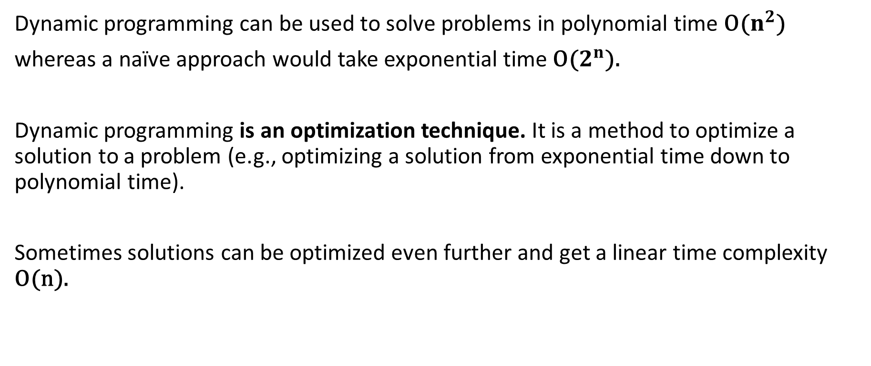
Why does Dynamic Programming exist?
INTRODUCTION TO COMPUTING
Course Code: CCINCOM/L
Dynamic programming can be used to solve problems in polynomial time O($n^{2}$)
whereas a naïve approach would take exponential time O($2^{n}$).
Dynamic programming is an optimization technique. It is a method to optimize a solution to a problem (e.g., optimizing a solution from exponential time down to polynomial time).
Sometimes solutions can be optimized even further and get a linear time complexity O(n).
Joseph Marvin R. Imperial
REINFORCEMENT LEARNING
NU College of Computing and Information Technologies
Course Code: CCRNFLRL

Slide 6
When to use Dynamic Programming?
INTRODUCTION TO COMPUTING
Course Code: CCINCOM/L
What are the characteristics of a problem that tells us that we can apply dynamic programming to solve it?
A problem must have two properties:
Optimal Substructure
Optimal simply means “the best ” or “most desirable”.
Substructure means the subproblem of a main problem.
A problem has an optimal substructure property when its optimal solution can be constructed from the optimal solutions of its subproblems.
By solving each subproblem in its most optimal way we obtain optimal solution to the main problem.
Joseph Marvin R. Imperial
REINFORCEMENT LEARNING
NU College of Computing and Information Technologies
Course Code: CCRNFLRL

Slide 7
Optimal Substructure
INTRODUCTION TO COMPUTING
Course Code: CCINCOM/L
Main Problem
Instead of solving the entire problem at once
Joseph Marvin R. Imperial
REINFORCEMENT LEARNING
NU College of Computing and Information Technologies
Course Code: CCRNFLRL

Slide 8
Optimal Substructure
INTRODUCTION TO COMPUTING
Course Code: CCINCOM/L
Subproblem 2
Subproblem 1
Subproblem 4
Subproblem 3
To get the optimal solution of the main problem, break it down into smaller subproblems and solve one problem at a time in an optimal way.
Joseph Marvin R. Imperial
REINFORCEMENT LEARNING
NU College of Computing and Information Technologies
Course Code: CCRNFLRL

Slide 9
Optimal Substructure
INTRODUCTION TO COMPUTING
Course Code: CCINCOM/L
Subproblem 2
Subproblem 1
Subproblem 4
Subproblem 3
Once an optimal solution is found for Subproblem 1, we can extend the problem space and solve Subproblem 2
Solving Subproblem 2 does not require resolving Subproblem 1. We can use the result of Subproblem 1 to solve Subproblem 2
This process is repeated until all subproblems are solved.
Joseph Marvin R. Imperial
REINFORCEMENT LEARNING
NU College of Computing and Information Technologies
Course Code: CCRNFLRL

Slide 10
Optimal Substructure
INTRODUCTION TO COMPUTING
Course Code: CCINCOM/L
Subproblem 2
Subproblem 1
Subproblem 4
Subproblem 3
This is the core idea of dynamic programming!
Joseph Marvin R. Imperial
REINFORCEMENT LEARNING
NU College of Computing and Information Technologies
Course Code: CCRNFLRL

Slide 11
When to use Dynamic Programming?
INTRODUCTION TO COMPUTING
Course Code: CCINCOM/L
Overlapping Subproblems
Fib(5)
Fib(4)
Fib(3)
Fib(3) was recalculated twice!
Fib(3)
Fib(2)
Joseph Marvin R. Imperial
REINFORCEMENT LEARNING
NU College of Computing and Information Technologies
Course Code: CCRNFLRL

Slide 12
How do we find problems that are perfect for DP?
INTRODUCTION TO COMPUTING
Course Code: CCINCOM/L
Combinatoric problems
How many ways to make a change?
How many ways to traverse a graph?
How many steps needed to get from point A to point B?
Your objective is to count something.
Optimization problems
What is the minimum number of steps needed to get from point A to point B?
What is the maximum profit gained by buying and selling stock?
What is the minimum cost to travel from Manila to Baguio?
Your objective is to minimize or maximize some function.
Joseph Marvin R. Imperial
REINFORCEMENT LEARNING
NU College of Computing and Information Technologies
Course Code: CCRNFLRL

Slide 13
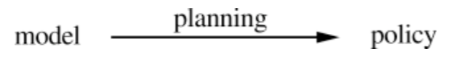
Planning
INTRODUCTION TO COMPUTING
Course Code: CCINCOM/L
Planning is any computational process that uses a model to create or improve a policy.
We take the following (unusual) view:
all state-space planning methods involve computing value functions, either explicitly or implicitly.
they all apply backups to simulated experience.
Joseph Marvin R. Imperial
REINFORCEMENT LEARNING
NU College of Computing and Information Technologies
Course Code: CCRNFLRL

Slide 14
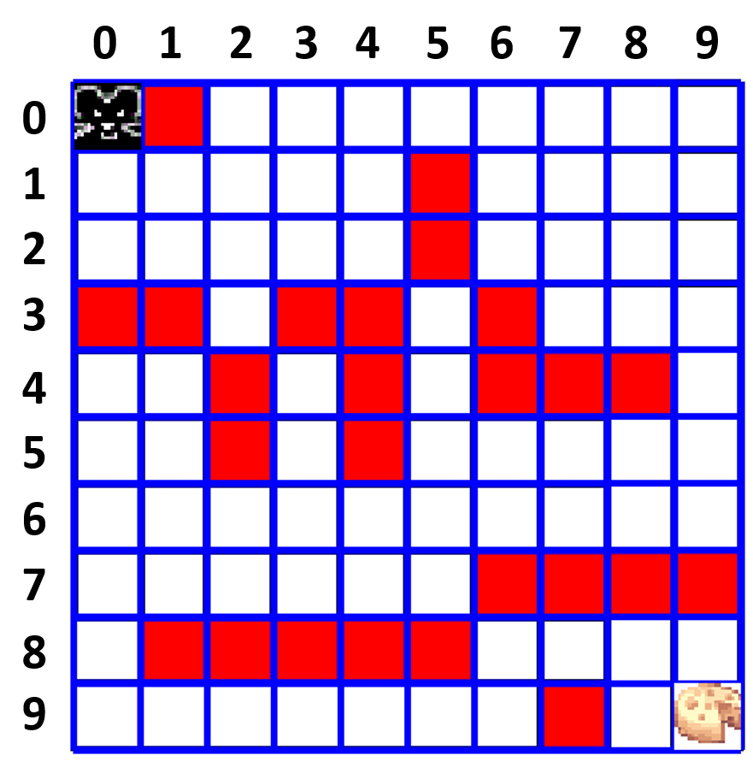
Plan and memorize!
Course Code: CCINCOM/L
Joseph Marvin R. Imperial
REINFORCEMENT LEARNING
NU College of Computing and Information Technologies
Course Code: CCRNFLRL

Slide 15
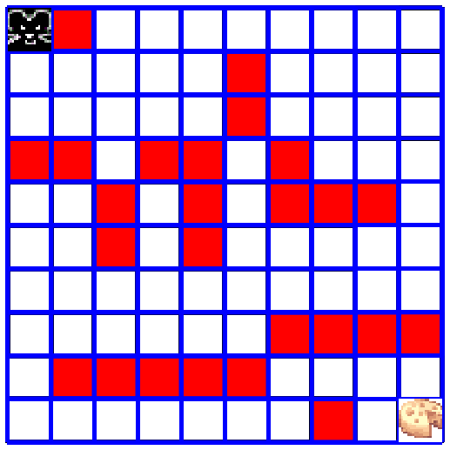
Solve with your knowledge (model)
Course Code: CCINCOM/L
Joseph Marvin R. Imperial
REINFORCEMENT LEARNING
NU College of Computing and Information Technologies
Course Code: CCRNFLRL

Slide 16
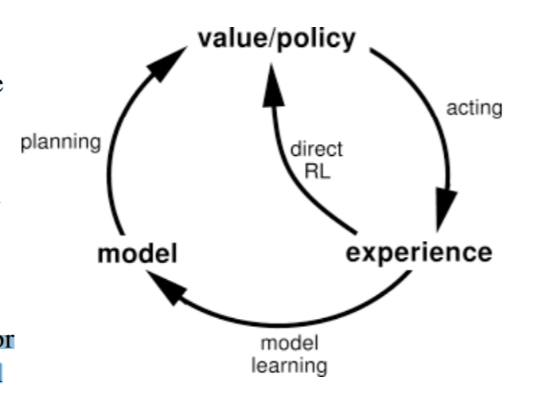
Learning, Planning, and Acting
INTRODUCTION TO COMPUTING
Course Code: CCINCOM/L
Two uses of real experience:
Direct RL - to directly improve the value function and policy
Indirect RL - to improve the learned model
Improving value function and/or policy via a model is sometimes called indirect RL or model-based RL or planning.
Joseph Marvin R. Imperial
REINFORCEMENT LEARNING
NU College of Computing and Information Technologies
Course Code: CCRNFLRL

Slide 17
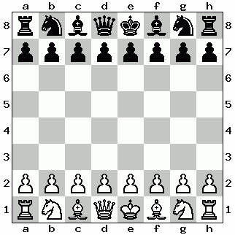
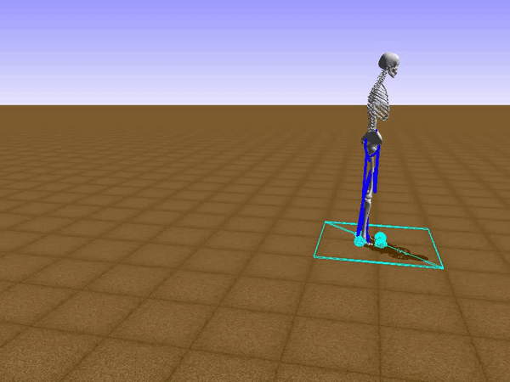
Direct vs Indirect RL
INTRODUCTION TO COMPUTING
Course Code: CCINCOM/L
Indirect (model-based) Methods:
make fuller use of experience
get better policy with fewer environment interactions
Direct Methods:
simpler
not affected by bad models
In some cases, planning, acting, model learning, and direct RL can occur simultaneously and in parallel.
Joseph Marvin R. Imperial
REINFORCEMENT LEARNING
NU College of Computing and Information Technologies
Course Code: CCRNFLRL

Slide 18
Planning by DP
INTRODUCTION TO COMPUTING
Course Code: CCINCOM/L
Dynamic programming assumes full knowledge of the MDP.
Planning has two components:
Prediction - RL is used to learn the value function for the policy followed. At the end of learning this value function describes for every visited state how much future reward we can expect when performing actions starting at this state.
Control - By interacting with the environment, we wish to find a policy which maximizes the reward when traveling through state space. At the end we have obtained an optimal policy which allows for action planning and optimal control.
Joseph Marvin R. Imperial
REINFORCEMENT LEARNING
NU College of Computing and Information Technologies
Course Code: CCRNFLRL

Slide 19
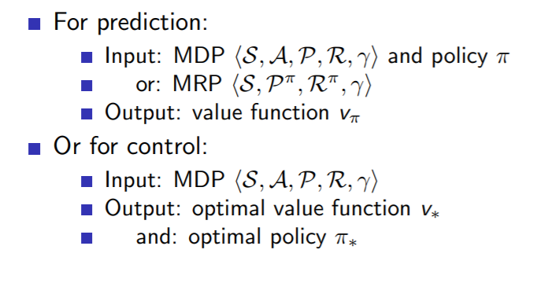
Planning by DP
INTRODUCTION TO COMPUTING
Course Code: CCINCOM/L
Take note of the inputs and outputs for each task.
Joseph Marvin R. Imperial
REINFORCEMENT LEARNING
NU College of Computing and Information Technologies
Course Code: CCRNFLRL

Slide 20
Outline
INTRODUCTION TO COMPUTING
Course Code: CCINCOM/L
Dynamic Programming
Policy Evaluation
Policy Iteration
Value Iteration
Joseph Marvin R. Imperial
REINFORCEMENT LEARNING
NU College of Computing and Information Technologies
Course Code: CCRNFLRL

Slide 21
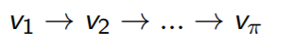
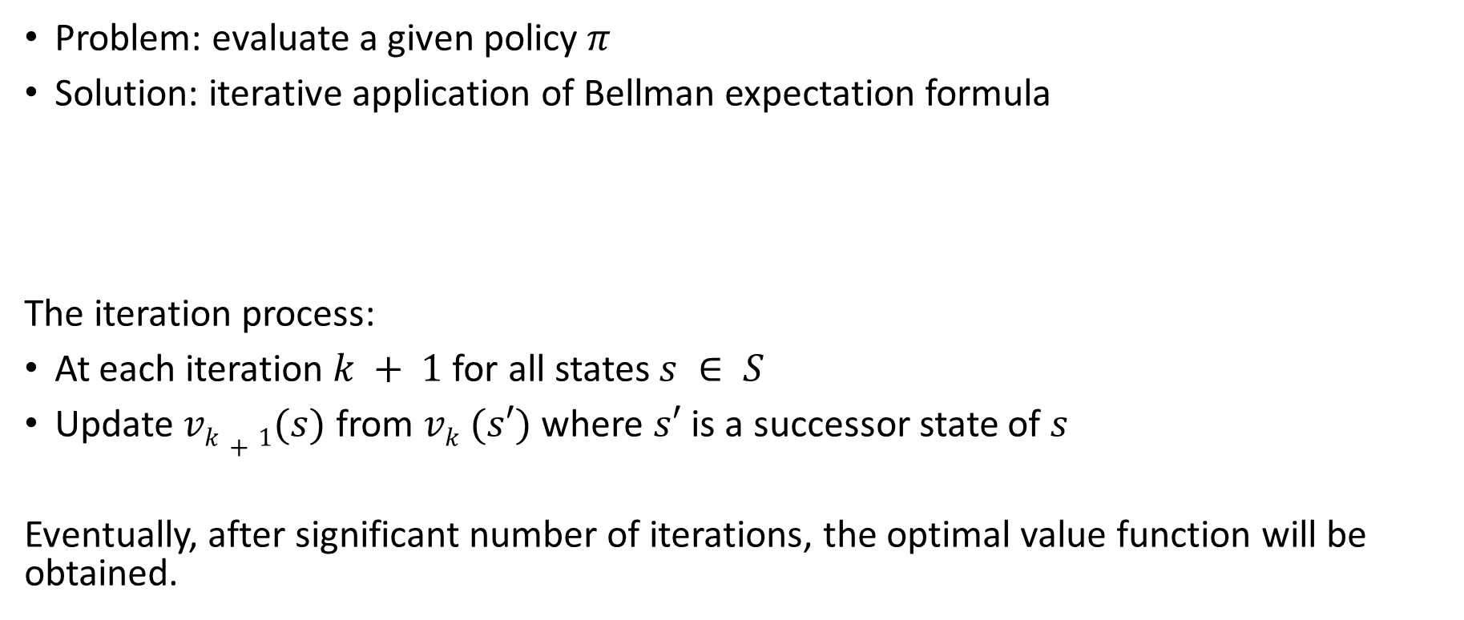
Iterative Policy Evaluation (Prediction Problem)
INTRODUCTION TO COMPUTING
Course Code: CCINCOM/L
Problem: evaluate a given policy$π$
Solution: iterative application of Bellman expectation formula
The iteration process:
At each iteration $k + 1$for all states $s ∈ S$
Update $vk+1(s)$ from $vk (s′)$where $s′$ is a successor state of $s$
Eventually, after significant number of iterations, the optimal value function will be obtained.
Joseph Marvin R. Imperial
REINFORCEMENT LEARNING
NU College of Computing and Information Technologies
Course Code: CCRNFLRL

Slide 22
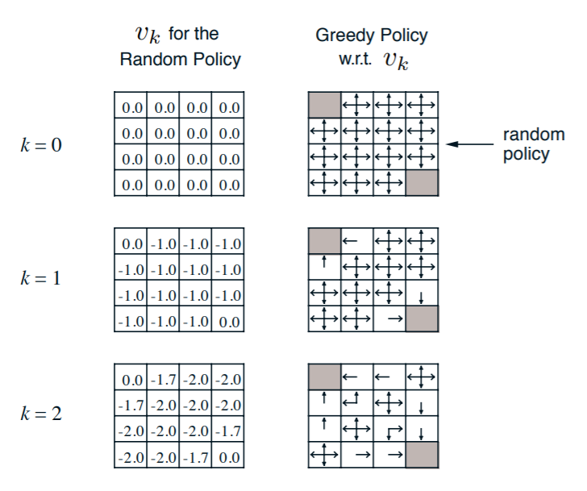
Iterative Policy Evaluation in Small Gridworld
INTRODUCTION TO COMPUTING
Course Code: CCINCOM/L
Joseph Marvin R. Imperial
REINFORCEMENT LEARNING
NU College of Computing and Information Technologies
Course Code: CCRNFLRL

Slide 23
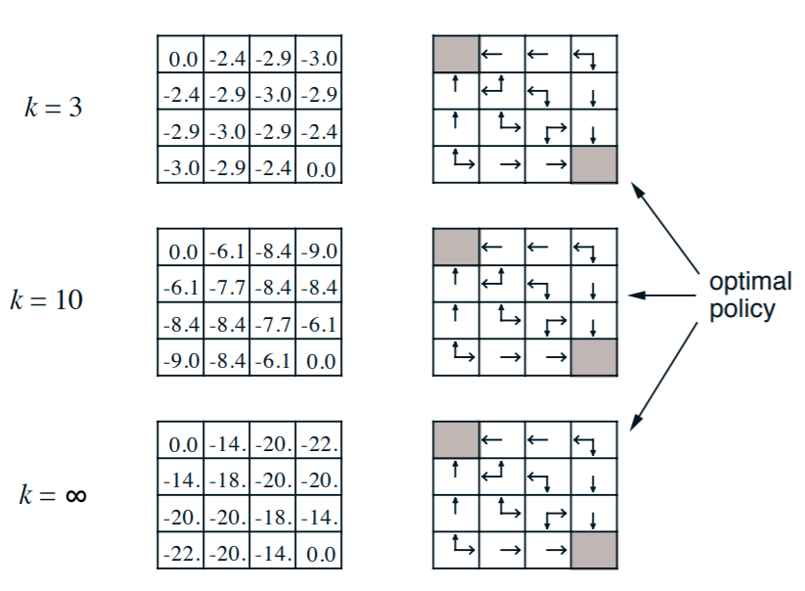
Iterative Policy Evaluation in Small Gridworld
INTRODUCTION TO COMPUTING
Course Code: CCINCOM/L
Joseph Marvin R. Imperial
REINFORCEMENT LEARNING
NU College of Computing and Information Technologies
Course Code: CCRNFLRL

Slide 24
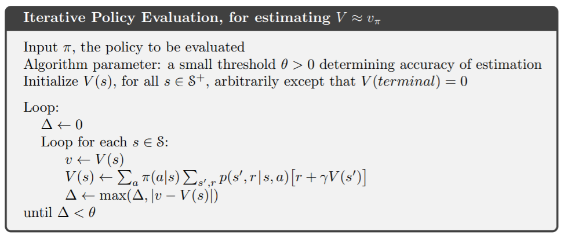
Iterative Policy Evaluation
INTRODUCTION TO COMPUTING
Course Code: CCINCOM/L
Joseph Marvin R. Imperial
REINFORCEMENT LEARNING
NU College of Computing and Information Technologies
Course Code: CCRNFLRL

Slide 25
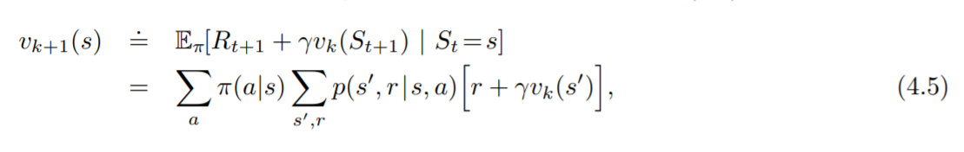

DP Implementation
INTRODUCTION TO COMPUTING
Course Code: CCINCOM/L
To write a sequential computer program to implement iterative policy evaluation as given by (4.5) you would have to use two arrays, one for the old values, v_{k}(s), and one for the new values, v_{k+1}(s).
With two arrays, the new values can be computed one by one from the old values without the old values being changed.
Bellman equation as an update rule for finding best$v(s)$function
Joseph Marvin R. Imperial
REINFORCEMENT LEARNING
NU College of Computing and Information Technologies
Course Code: CCRNFLRL

Slide 26
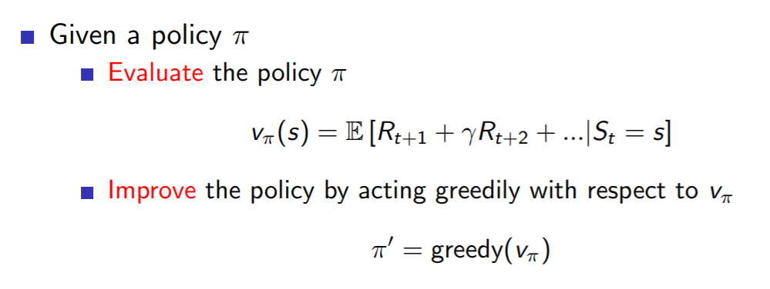
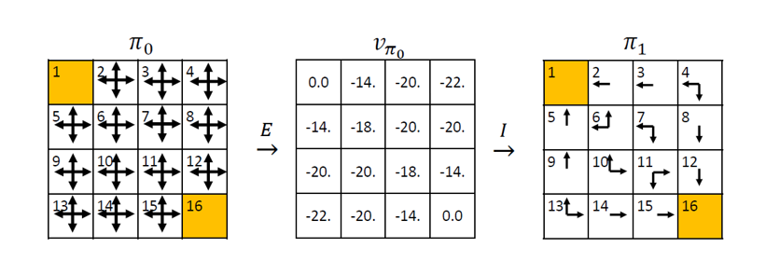
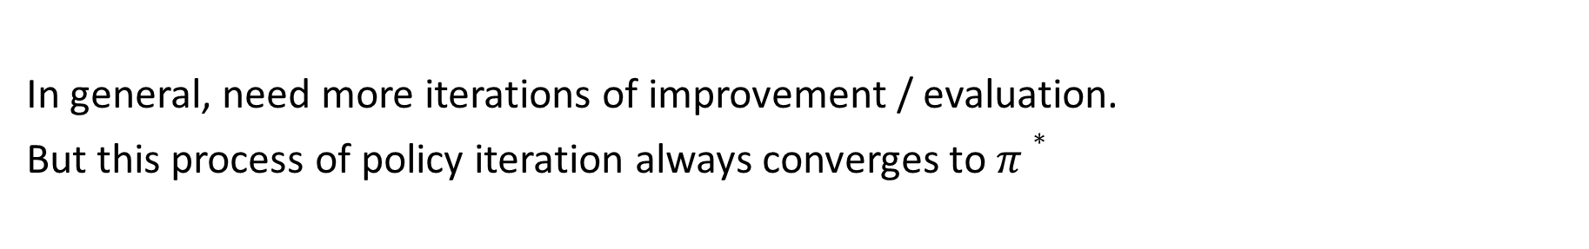
Policy Improvement
INTRODUCTION TO COMPUTING
Course Code: CCINCOM/L
Our reason for computing the value function for a policy is to help find better policies.
In general, need more iterations of improvement / evaluation.
But this process of policy iteration always converges to $π∗$
Joseph Marvin R. Imperial
REINFORCEMENT LEARNING
NU College of Computing and Information Technologies
Course Code: CCRNFLRL

Slide 27
Outline
INTRODUCTION TO COMPUTING
Course Code: CCINCOM/L
Dynamic Programming
Policy Evaluation
Policy Iteration
Value Iteration
Joseph Marvin R. Imperial
REINFORCEMENT LEARNING
NU College of Computing and Information Technologies
Course Code: CCRNFLRL

Slide 28
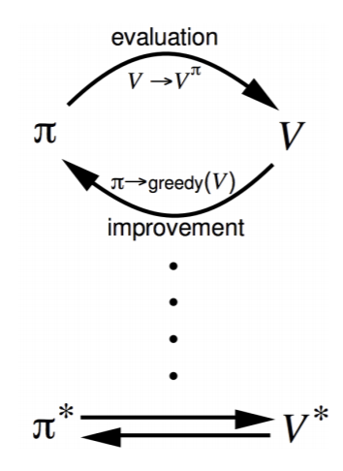
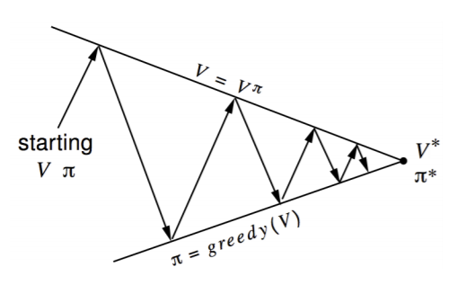
Policy Iteration
INTRODUCTION TO COMPUTING
Course Code: CCINCOM/L
Policy evaluation - estimate v_{π}
Policy improvement - generate π₀ ≥ π
Joseph Marvin R. Imperial
REINFORCEMENT LEARNING
NU College of Computing and Information Technologies
Course Code: CCRNFLRL

Slide 29
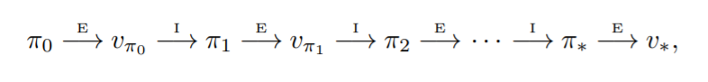
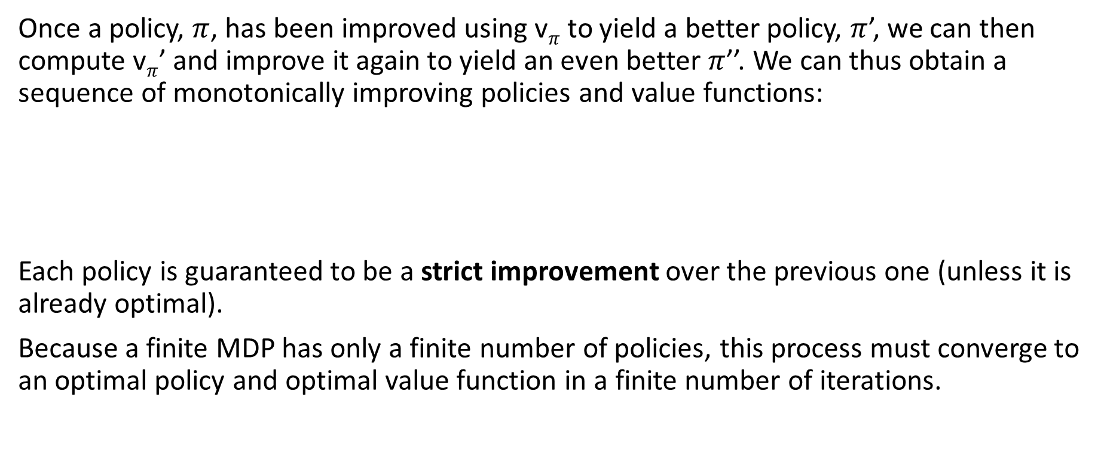
Policy Iteration
INTRODUCTION TO COMPUTING
Course Code: CCINCOM/L
Once a policy, $π$, has been improved using v$π$to yield a better policy, $π$’, we can then compute v$π$’ and improve it again to yield an even better $π$’’. We can thus obtain a sequence of monotonically improving policies and value functions:
Each policy is guaranteed to be a strict improvement over the previous one (unless it is already optimal).
Because a finite MDP has only a finite number of policies, this process must converge to an optimal policy and optimal value function in a finite number of iterations.
Joseph Marvin R. Imperial
REINFORCEMENT LEARNING
NU College of Computing and Information Technologies
Course Code: CCRNFLRL

Slide 30
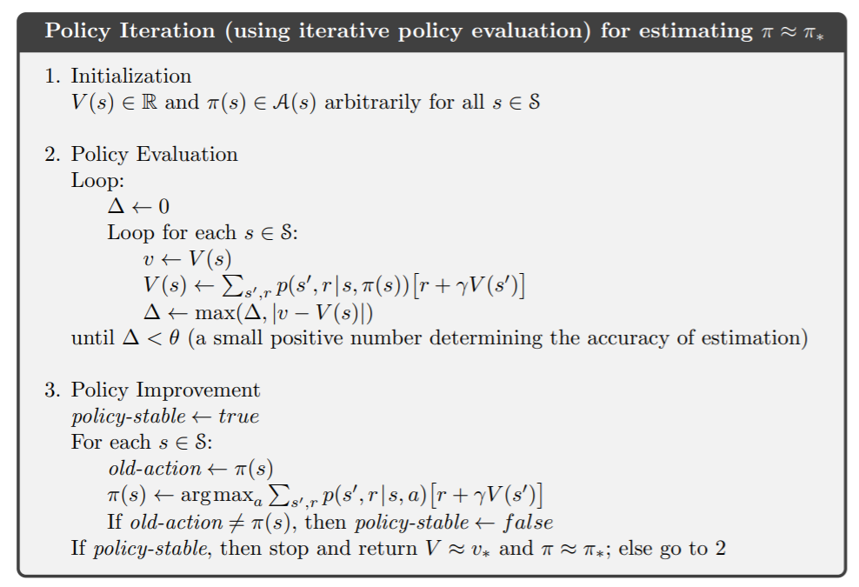
INTRODUCTION TO COMPUTING
Course Code: CCINCOM/L
Joseph Marvin R. Imperial
REINFORCEMENT LEARNING
NU College of Computing and Information Technologies
Course Code: CCRNFLRL

Slide 31

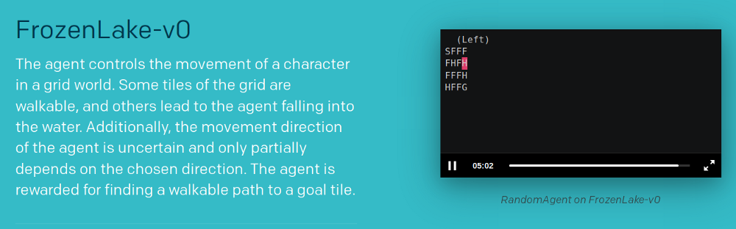
Policy Evaluation & Iteration (Code)
INTRODUCTION TO COMPUTING
Course Code: CCINCOM/L
For the rest of the class time, you will be experimenting with the implementation of policy evaluation and policy iteration in Python using OpenAI Gym.
https://gym.openai.com/envs/FrozenLake-v0/
Joseph Marvin R. Imperial
REINFORCEMENT LEARNING
NU College of Computing and Information Technologies
Course Code: CCRNFLRL

Slide 32
References
INTRODUCTION TO COMPUTING
Course Code: CCINCOM/L
Images are licensed with Creative Commons. Can use without citing.
Prof. Emma Brunskill’s slides (CS234RL). https://web.stanford.edu/class/cs234/slides/lecture1.pdf
David Silver’s slides. https://www.davidsilver.uk/wp-content/uploads/2020/03/intro_RL.pdf
Review in Probability, Intro to RL Concepts
Joseph Marvin R. Imperial
REINFORCEMENT LEARNING
NU College of Computing and Information Technologies
Course Code: CCRNFLRL

